Slide 1

SYSTEM LOG MONITOR
Presented by :-
Akash Chaudhary Sawan Misra
2022021204 2022021252
B.Tech 3rd year B.tech 3rd year
Under the guidance of
Prof. Manish Kumar Srivastava

Slide 2
TABLE OF CONTENTS
1. OBJECTIVE | 2. INTRODUCTION | 3.ABOUT LOGS | 4. SYSTEM ARCHITECTURE
5. IMPLEMENTATION DETAIL | 6. RESULTS | 7. FUTURE SCOPE | 8. CONCLUSION

Slide 3
OBJECTIVES
The software will provide user kernel log data which could be used for:-
Provide user friendly GUI interface to access and analyze logs
Eliminate need for complex command lines
Allows futures enhancement like going web

Slide 4
INTRODUCTION
This project creates log monitoring system where logs information would be provided to the user.
Instead of using command lines it provide simple GUI based approach for handling the logs.

Slide 5
About logs
In linux logs are text/binary files that record events, messages, and activities generated by the system, kernel, services, and applications.
TYPES OF LOG FILES
SYSTEM LOGS
APPLICATION LOGS
SERVICE LOGS
USER LOGS
SYSTEM ACTIVITY ,
KERNEL MESSAGE,
BOOT LOGS
MAIL LOGS,
SERVER LOGS
BACKFROUND PROCESSES
RECORDS OF LOGIN
AND LOGOUT

Slide 6
SYSTEM ARCHITECTURE
LINUX
LOG
FILES
LOGGING,
OS.SYSTEM, SUBPROCESS MODULE
TKINTER MODULE

Slide 7
IMPLEMENTATION
The project would be implemented in two phase using python.
FRONTEND PHASE
STEP1: INSTALLING DEPENDENCIES (EG. LINUX UPDATION)
STEP2: INSTALLING REQUIRED SYSTEM PACKAGES (EG.TKINTER)
STEP 3: PRODUCE THE FRONTED STRUCTURE USING TKINTER MODULE

Slide 8
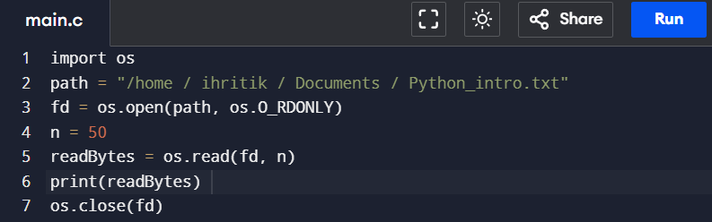
BACKEND PHASE
STEP 1: FETCH LOGS USING OS(OS.SYSTEM) MODULES
STEP 2: FETCH SYSTEM PROCESS FROM SUBPROCESS MODULE
STEP 3: DISPLAY IT ON UI

Slide 9
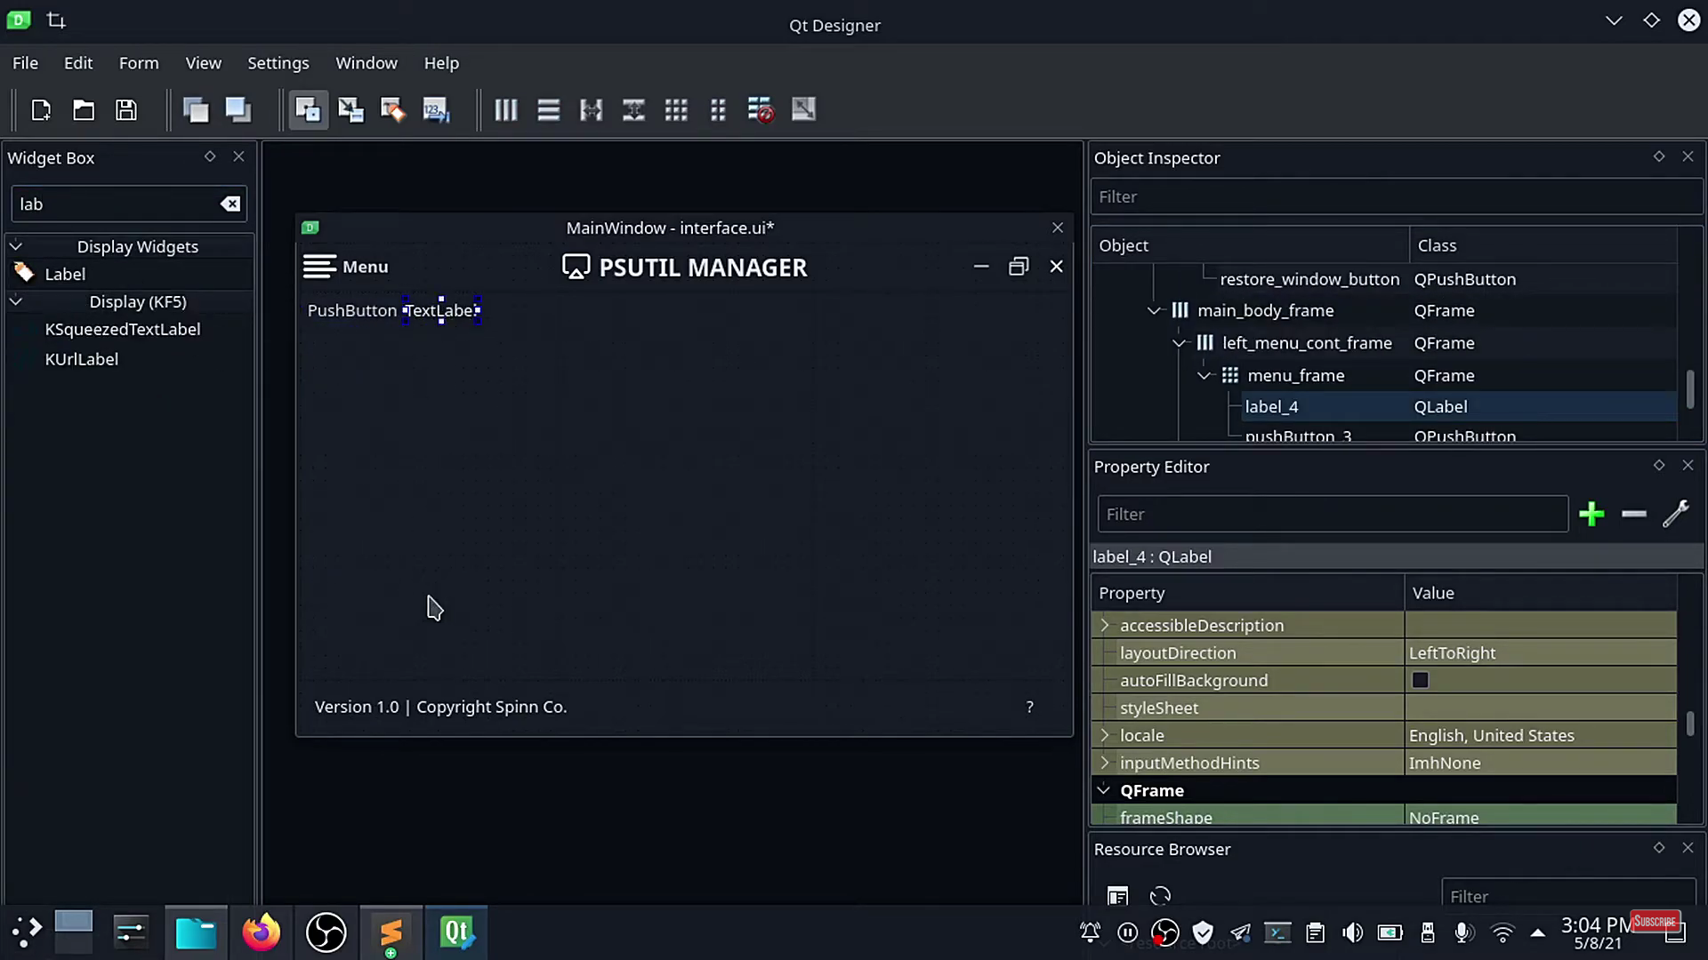
RESULT
This picture is just for reference only and does not posses by me.

Slide 10
FUTURE SCOPE
IF SOMETHING MALICIOUS FOUND AN ALERT WOULD BE TRANSMITTED.
WOULD PROVIDE FUNCTIONS FOR OTHER LINUX FLAVOUR
CONCLUSION
THE KERNEL MONITORING WOULD REDUCE THE BURDEN OF LEARNING EXTRAS FOR THE DEVELOPERS,
BEGINNER USED COULD EVEN USE IT FOR THEIR BENEFITS.
WORKS GREAT FOR THE SECURITY AND RESOURCE MANAGEMENT PURPOSE.

